Slide 1

Security Analysis of the
Internet Architecture
Master Thesis - Marco Seewer
Supervised by Roland Meier, Jordi Nieto, and Adrian Perrig
This research is supported by armasuisse Science and Technology.
Notes:
Dear Prof. Perrig
Dear Supervisors
And everybody else
I welcome you to my Masters Thesis Presentation
This was joint work of CYD + ETH
My task = conduction security analysis of SCION in a real deployment

Slide 2


SWITCH
AS: 559
Setup CYD Testbed:
3 ASes
3 Core ASes
  SCION Production Network
Anapaya Routers
  3 operational
  1 offline test device
Swisscom
AS: 3303
Sunrise
AS: 6730
Zurich AS:
2:0:2b
Thun AS:
2:0:2c
Lausanne AS:
2:0:2d

Slide 3

WHY?
Notes:
Security built in
Partially formally verified

Slide 4


Problem
SCION protocol implementation:
Anapaya version Open-source version
Anapaya devices
Notes:
Security guarantees not implied

Slide 5


Focus
Security of Operational Devices
SCION Network in use
Volumetric Impact

Slide 6

Process
Independent security analysis
Disclosure with Anapaya
Software updates
Approval for publication/presentation
Attacker models:
  SCION end-host
  On-path
  Off-path
  Non-SCION adversary
Notes:
Results: mainly attacker models of
end-host + non-scion

Slide 7

1) Anapaya’s SCION device

Slide 8
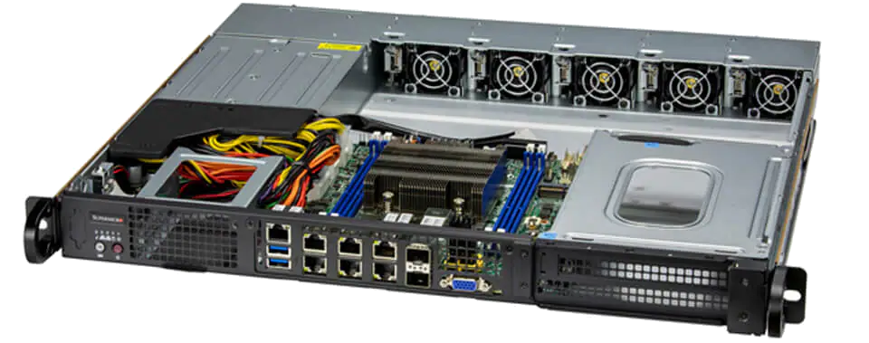
Anapaya Device
Unauthenticated + authenticated vulnerability scans
Scan results applicable (threat model: No local access)
Compliance scans
Docker images
Open ports + running services
Exposure of systemd services
SSH configurations
SCION configuration (Management system)
https://www.supermicro.com/files_SYS/images/System/SYS-110D-8C-FRAN8TP_main.jpg
Notes:
Operational devices
Automated scans + manual investigation

Slide 9

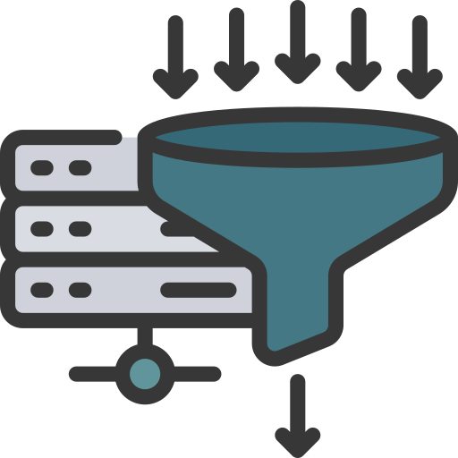
SSH Configuration
Only public-key authentication
Some less secure algorithms enabled
No rate limiting → DHEat attack:
  Send many DH keys (or random big numbers)
  Expensive modular exponentiation → CPU
  SCION services unaffected
Notes:
Short 64 tag size
Not always etm

Slide 10
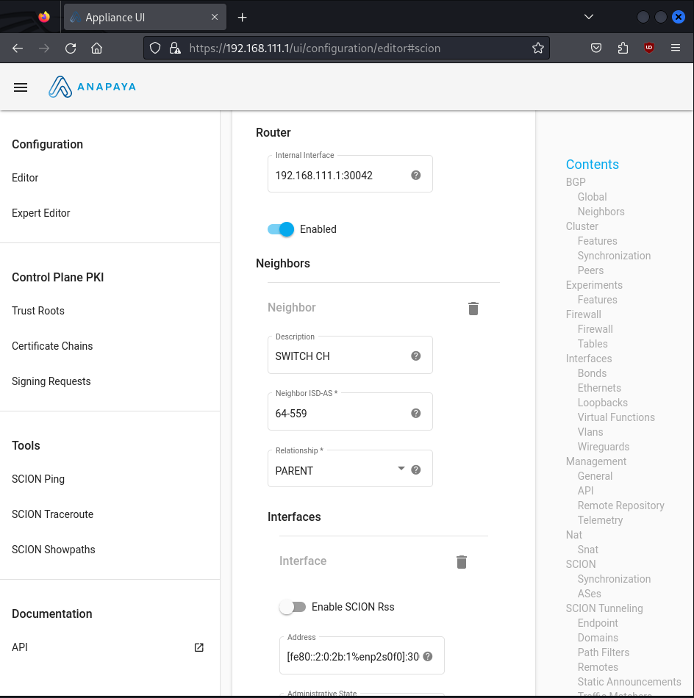


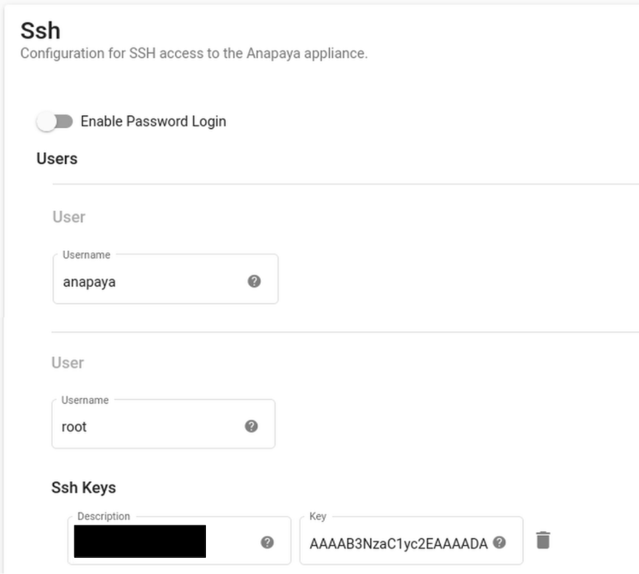

Management System
No authentication enabled!
Every CYD SCION user can:
  Change configuration
  Upload/Install/Delete any packages (binaries)
  Add new TRC
Add/Delete Users + SSH keys
Notes:
No default authentication
Ssh keys:
Lack of authentication in Management system
→ leads to full compromise of devide

Slide 11
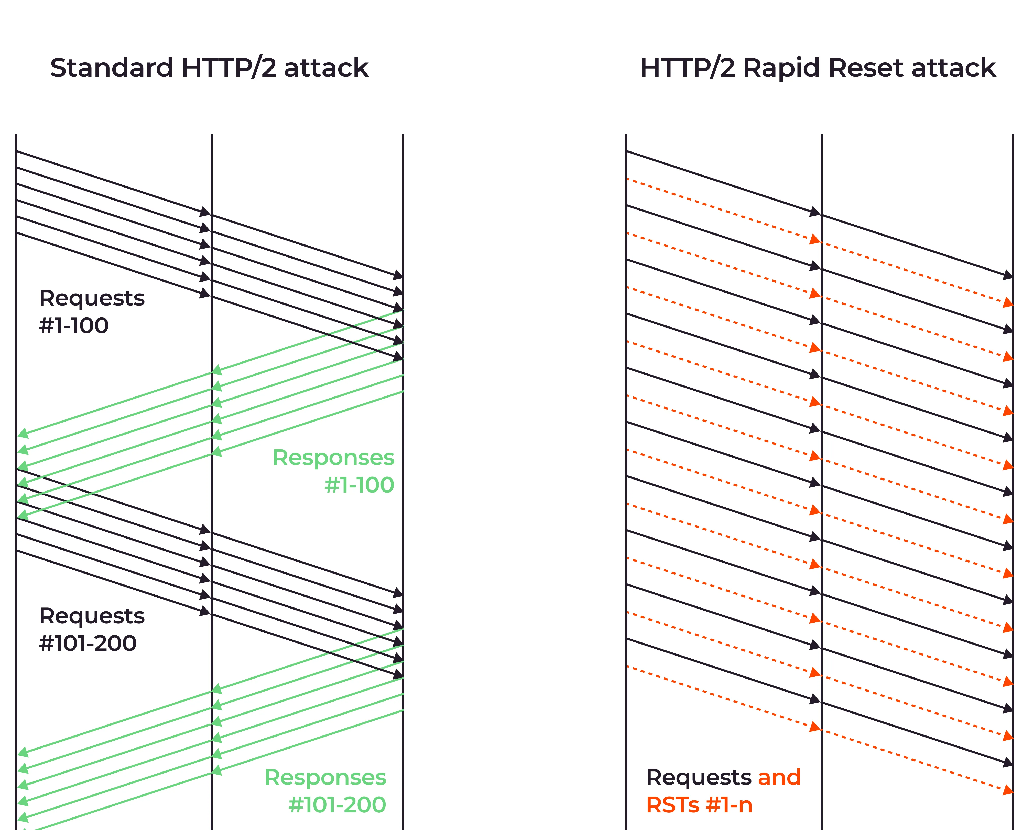

Management System
Webserver (Caddy) vulnerable
HTTP/2 Rapid Reset
Resource exhaustion
Works even with enabled authentication
Demo
Notes:
1 TCP connection

Slide 12
2) Anapaya’s SCION protocol

Slide 13


SCION Protocol – Anapaya Version
Cryptography
  Hop Field MAC - Algorithm
  Source Authentication – DRKey
Packet Manipulation
  Field/header modifications
  Path modification (Path splicing, path extension)
  Spoofing
Notes:
main focus: these 2 points

Slide 14
Cryptography
Hop Field MAC
  Anapaya == Open-source (AES-CMAC)
  Master Secret (used to derive MAC key) fixed →never refreshed
Check if MAC is verified
Notes:
Same algo (good)
Actually verified?

Slide 15

AS:12350
SWITCH
AS: 559
AS:15623
Swisscom
AS: 3303
Path splicing: Combine hops of different paths
Sunrise
AS: 6730
Zurich AS:
2:0:2b
Thun AS:
2:0:2c
Lausanne AS:
2:0:2d
Notes:
Attack Not working → MAC check

Slide 16
Cryptography
Hop Field MAC
  Anapaya == Open-source (AES-CMAC)
  Master Secret (used to derive MAC key) fixed →never refreshed
  MAC is verified by routers
DRKey
  Not enabled/available
  → No source authentication (SPAO) possible
  Unauthenticated SCMP error messages
Notes:
→ spoof source info?

Slide 17

SWITCH
AS: 559
Swisscom
AS: 3303
Sunrise
AS: 6730
Source Address Spoofing
No AS/Address filtering
If destination performs path-lookup → Works
Can we force path-lookup?
Zurich AS:
2:0:2b
SRC: 2:0:2c
DST: 2:0:2d
Thun AS:
2:0:2c
SRC: 2:0:2d
DST: 2:0:2c
Lausanne AS:
2:0:2d
Notes:
Source set to Thun
No egress filtering

Slide 18

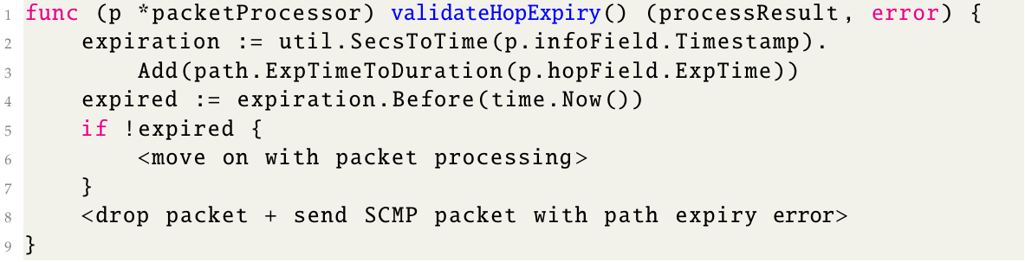
Spoofing
Protocol Divergence
Force path lookup with soon-to-expire paths
Feasibility depends on application
Valid path information got rejected (30s before actual expiry)
Notes:
What started as a spoofing attempt
Resulted in finding a protocol divergence

Slide 19

3) Volumetric Impact

Slide 20
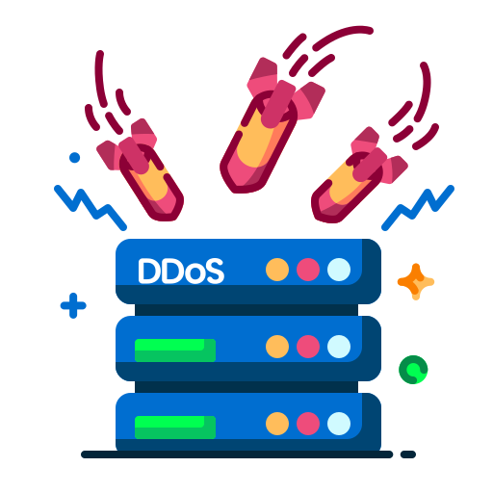

Volumetric Denial of Service
Traditional Internet
SCION
SWITCH
40 Gbps
10 Gbps
ETH
CYD
40 Gbps
10 Gbps
Notes:
Thank to Jordi + Francois
Trex (allowance up to 20Gbps)

Slide 21
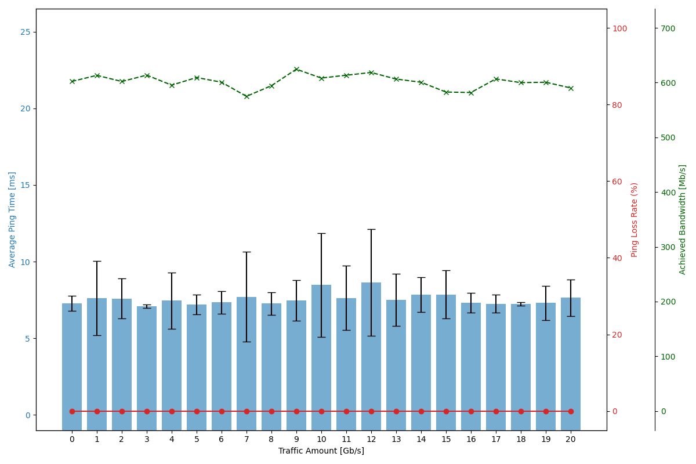
Impact of Volumetric Internet Traffic
Notes:
Thun
Scion ping
Scion bwtester
No impact

Slide 22
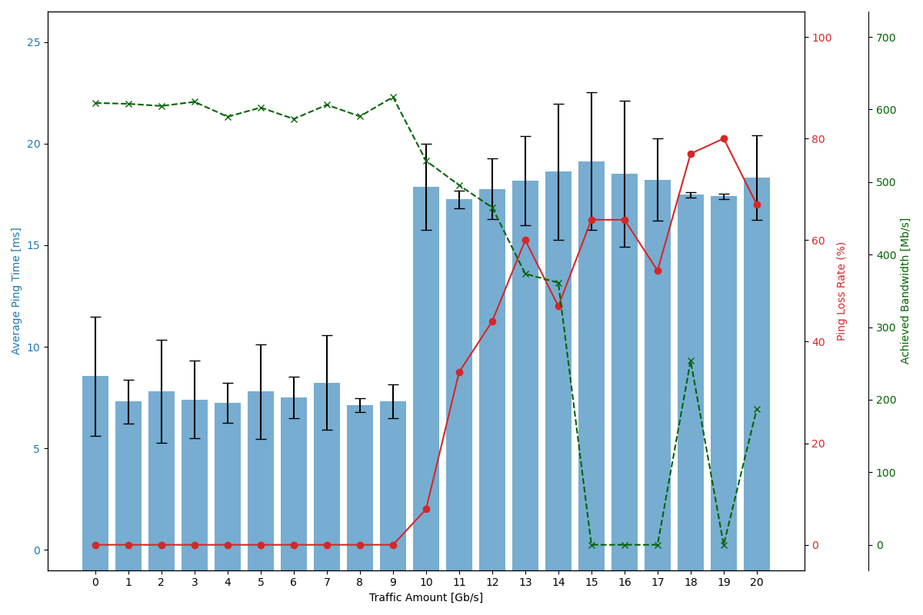
Impact of Volumetric SCION Traffic
Notes:
1 measurement

Slide 23

Conclusion
Security Analysis:
  Devices
  Protocol
  Impact
Anapaya fixed most of the shortcomings
Future work:
  Other Anapaya products
  Control plane
  Deployment

Slide 24
Internet
SCION

Slide 25
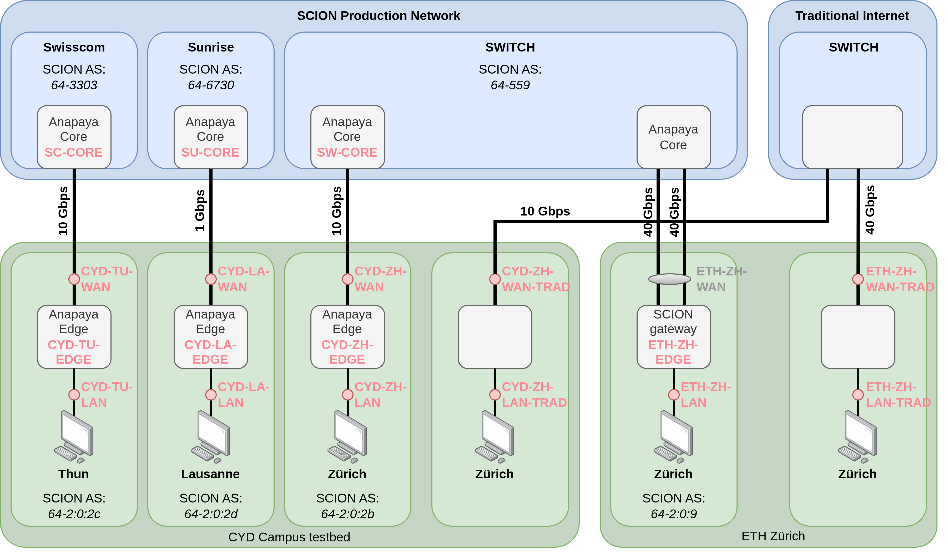

Slide 26


On Device Security
Outdated + vulnerable software (need local access to exploit)
Driver of Intel Ethernet Controller (Privilege escalation)
→ Potentially remotely exploitable
Distroless Debian (still contains vulnerable openssl version)
→ Command injection, use-after-free, double-free, DoS
Notes:
Operational devices
Automated scans + manual investigation

Slide 27
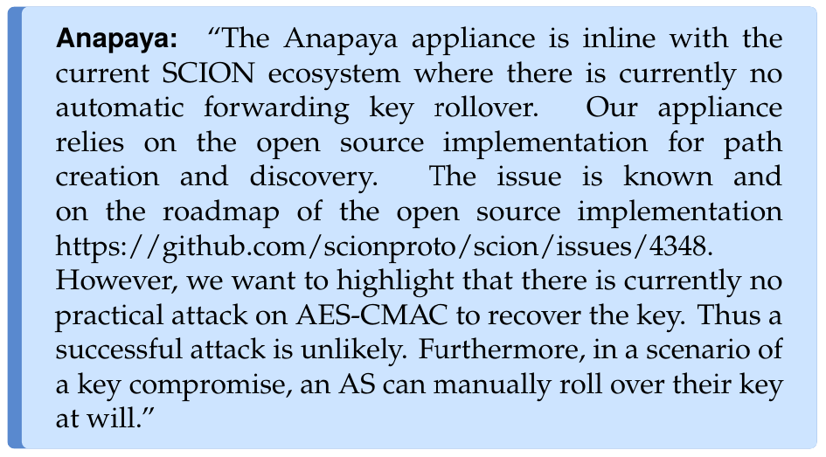
Master Key Refreshment

Slide 28
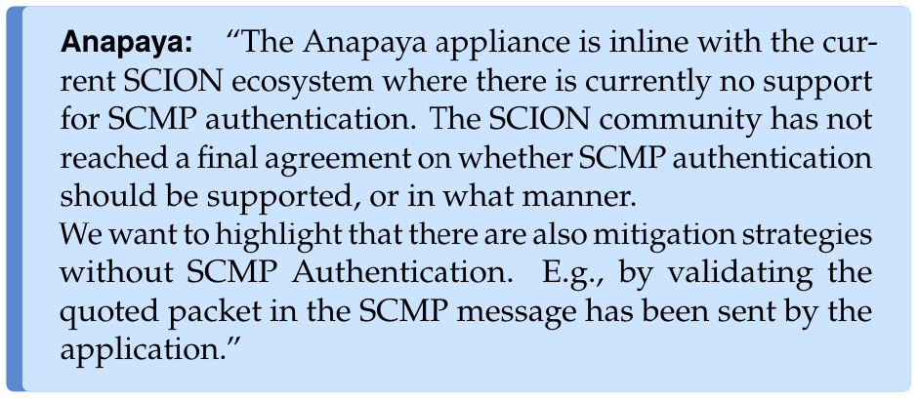
SCMP Authentication

Slide 29
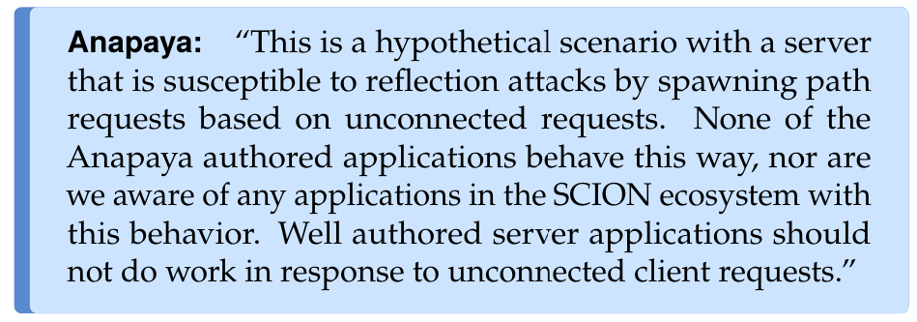
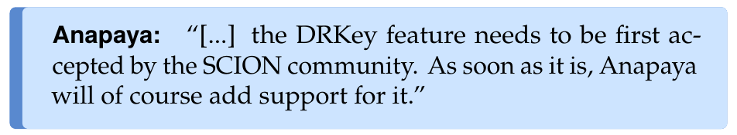
Spoofing

Slide 30
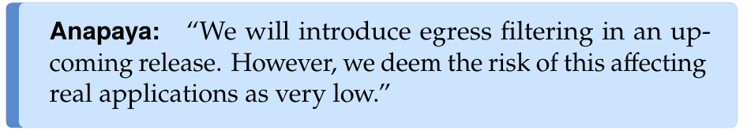
Egress filtering

Slide 31
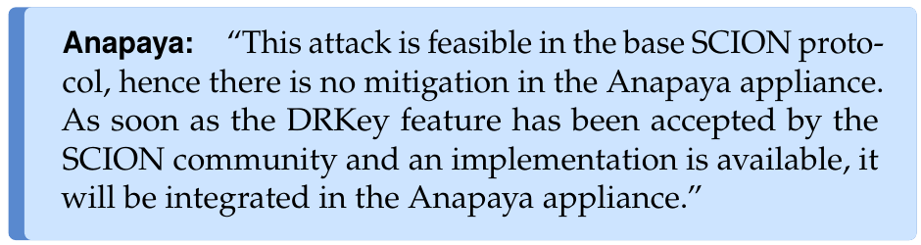
Path Header Modification (On-path)

Slide 32
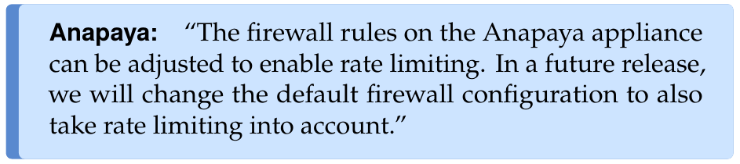
SSH Rate Limiting

Slide 33
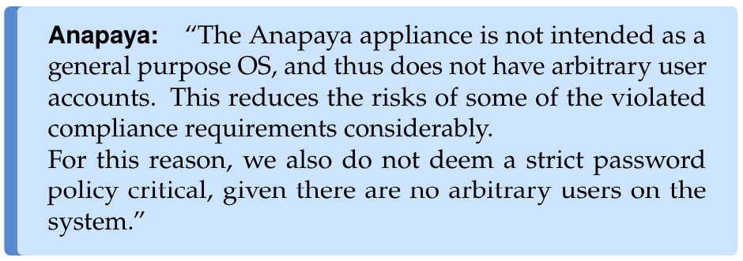
Ubuntu CIS Compliance Audit

Slide 34
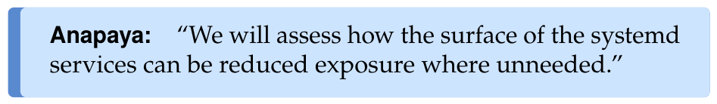
Systemd Services
ModemManager (3G/4G/5G)
systemd-rfkill (for WiFi/Bluetooth)
open-vm-tools
ubuntu-advantage
appliance-controller and appliance-installer

Slide 35
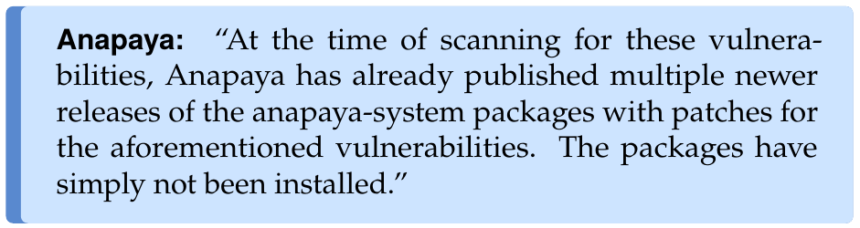
Device Software Vulnerabilities

Slide 36
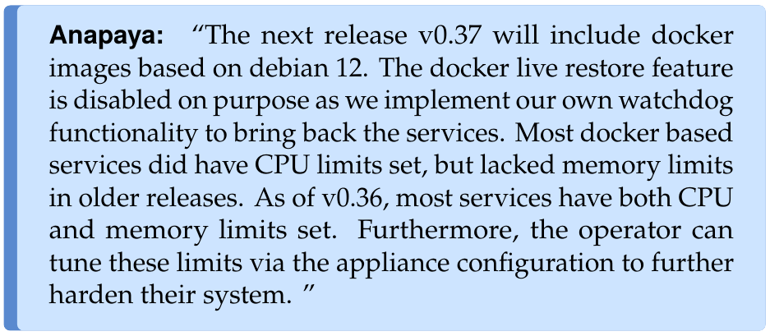
Docker Images

Slide 37
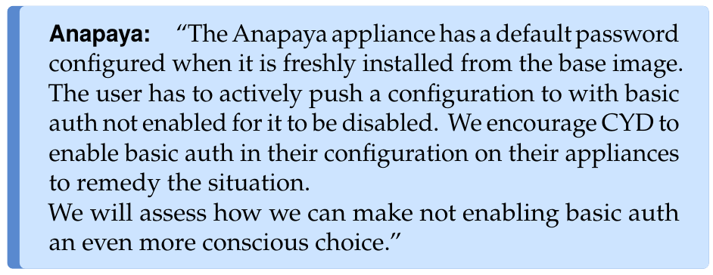
Authentication on Management System

Slide 38
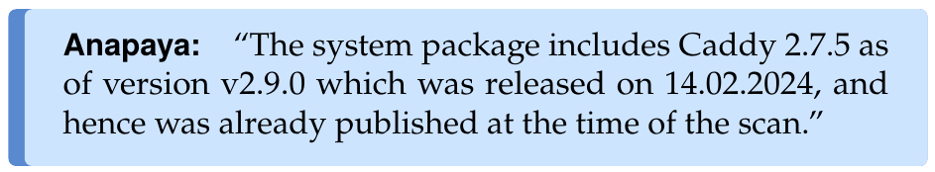
Rapid Reset – Caddy

